Slide 1

Creating Classes & Objects
By Min Thet Naing

Slide 2

Creating Class
By Min Thet Naing

Slide 3
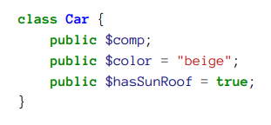
Add Properties to a Class
By Min Thet Naing

Slide 4

Creating Objects from a Class
By Min Thet Naing

Slide 5
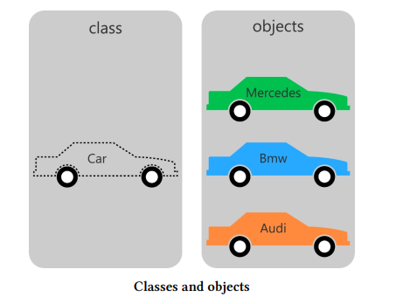
What are Objects good for?
By Min Thet Naing

Slide 6


Getting Object’s Properties
By Min Thet Naing

Slide 7


Setting Object’s Properties
By Min Thet Naing

Slide 8
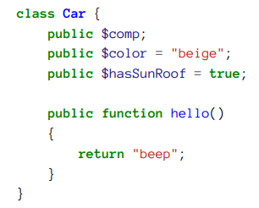
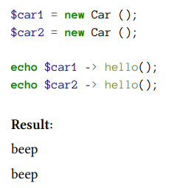
Add methods to a Class
By Min Thet Naing

